Slide 1
Photosynthesis in Higher plants

Slide 2
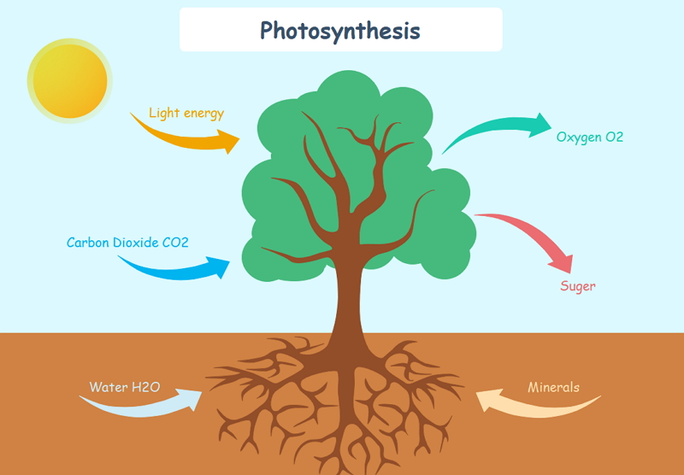

Slide 3
Introduction
Photosynthesis is an enzyme regulated anabolic process of manufacture of organic compounds inside the chlorophyll containing cells from carbon dioxide and water with the help of sunlight as a source of energy.
Photosynthesis is a chemical process, uses light energy to synthesis organic compounds (sugar).
Importance of photosynthesis includes:
•
Primary source of food
Release O₂ to atmosphere

Slide 4
Early Experiments
•
Joseph Priestley in 1770 performed a series of experiments with bell jar, candle & mouse
Priestley observed that a candle burning in a closed bell jar, soon gets extinguished.
Similarly, a mouse would soon suffocate in a closed space.
He concluded that a burning candle or an animal that breathe the air, both somehow, damage the air.
But when he placed a mint plant in the same bell jar, he found that the mouse stayed alive and the candle continued to burn.
Priestley hypothesized as follows: Plants restore to the air whatever breathing animals and burning candles remove.
•
•
•
•
•

Slide 7
Jan Ingenhousz (1730-1799) showed that sunlight is essential to the plant process that somehow purifies the air fouled by burning candles or breathing animals.
He performed experiment with an aquatic plant & showed that in bright sunlight, small bubbles were formed around the green parts while in the dark they did not.
Later he identified these bubbles to be of oxygen. Hence he showed that it is only the green part of the plants that could release oxygen.
•

Slide 8
In 1854, Julius von Sachs proved that plant produce glucose while growing & stores them as starch.
He explained that plant have green substance which is present within a cell in specialized bodies
He found that the green parts in plants is where glucose is made, and that the glucose is usually stored as starch.
T.W. Engelmann: Spilt light using prism (VIBGYOR) - Green algae Cladophora placed in a suspension of aerobic bacteria - Bacteria were used to detect the sites of O₂ evolutions.
He observed that the bacteria accumulated mainly in the region of blue and red light of the split spectrum. It explained the absorption spectra of chlorophyll a and b

Slide 9
Key features of photosynthesis was first explained in nineteenth century & that plants could use light energy to make carbohydrates from CO₂ and water.
The empirical equation representing the total process of photosynthesis for oxygen evolving organisms was then understood as:
•
where [CH₂O] represented a carbohydrate

Slide 10
Cornelius van Niel: He did experiment with purple and green bacteria and demonstrated photosynthesis is a light dependent process
He explained hydrogen from H₂O reduces CO₂ to carbohydrates. He concluded that oxygen comes from H₂O, and not from CO₂. Finally, the correct equation for photosynthesis was discovered.
6CO₂ + 12H₂O C₆H₁₂O₆ + 6H₂O + 6O₂
•

Slide 11
Site of Photosynthesis
Photosynthesis takes place only in green parts of the plant, mostly in leaves.
Within a leaf, photosynthesis occurs in mesophyll cells which contain the chloroplasts.
Chloroplasts are the actual sites for photosynthesis.
The thylakoids in chloroplast contain most of pigments required for capturing solar energy to initiate photosynthesis.
The membrane system (grana) is responsible for trapping the light energy and for the synthesis of ATP and NADPH. Biosynthetic phase (dark reaction) is carried in stroma where CO₂ is reduced to carbohydrate.
•
•
•
•

Slide 12
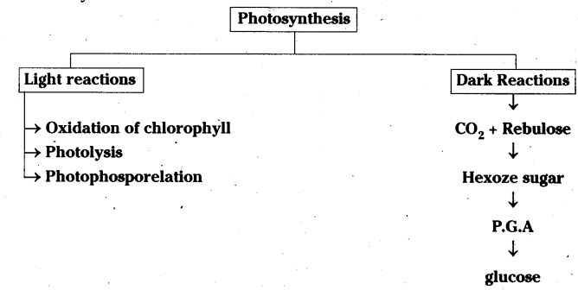

Slide 14
Pigments involved in Photosynthesis
•
•
Chlorophyll a : (Bright or blue green in chromatograph).
Major pigment, act as a reaction center, involved in trapping and converting light into chemical energy
Chlorophyll b : (Yellow green)
Xanthophyll : (Yellow)
Carotenoid : (Yellow to yellow-orange)
•
•
•
•
In the blue and red regions of spectrum shows higher rate of photosynthesis.

Slide 15
What is Light reaction?
•
•
Process which takes place in the presence of light only.
Light reactions or the ‘Photochemical ‘phase includes light absorption, splitting of water, evolution of oxygen and formation of high energy compound like ATP and NADPH.
It involves several complex & the pigments of the complex are organized into two discrete photochemical light harvesting complexes (LHC)- Photosystem I (PS I) and Photosystem II (PS II).
Light Harvesting Complexes (LHC) : The light harvesting complexes are made up of hundreds of pigment molecules bound to protein within the photosystem I (PSI) and photosystem II (PSII).
•
•

Slide 17
Each photosystem has all the pigments bound to protein except one molecule of chlorophyll ‘a’ forming a light harvesting system (antennae).
Pigments absorbs different wavelength of light for efficient photosynthesis
The reaction center (chlorophyll a) is different in both the photosystems.
Photosystem I (PSI) : Chlorophyll ‘a’ has an absorption peak at 700 nm (P700).
Photosystem II (PSII) : Chlorophyll ‘a’ has absorption peak at 680 nm (P680).
•
•

Slide 18
Process of Photosynthesis
Photochemical phase (Light reaction) : This phase includes - light absorption, splitting of water, oxygen release and formation of ATP and NADPH.
Biosynthetic phase (Dark reaction) : It is light independent phase, synthesis of food material (sugars).
It includes two phases - Photochemical phase and biosynthetic phase.
•
•
•

Slide 19
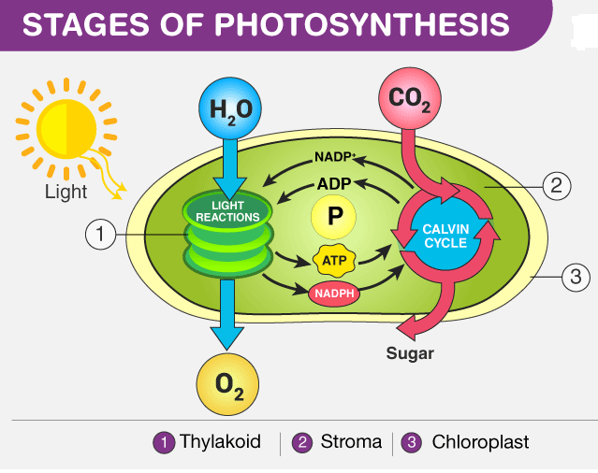

Slide 20
HILL REACTION or LIGHT REACTION
The Hill reaction is the light-driven transfer of electrons from water to Hill reagents (non-physiological oxidants) in a direction against the chemical potential gradient as part of photosynthesis. Robin Hill discovered the reaction in 1937.
Robert Hill (2 April 1899 – 15 March 1991), known as Robin Hill, was a British plant biochemist who, in 1939, demonstrated the 'Hill reaction' of photosynthesis, proving that oxygen is evolved during the light requiring steps of photosynthesis.

Slide 21
The Electron Transport System
In photosystem center chlorophyll a absorbs 680 nm wavelength of red light causing electrons to become excited and release two electrons from the atomic nucleus.
These electrons are accepted by primary electron acceptor i.e. Pheophytin, plastoquinone ,plastocyanin, ferredoxin etc.
The electron from the ferredoxin passed to electron transport system consisting cytochromes.
The electron moved in down hill in terms of redox potential by oxidation-reduction reactions.
Finally the electron reached photosystem-I.

Slide 24
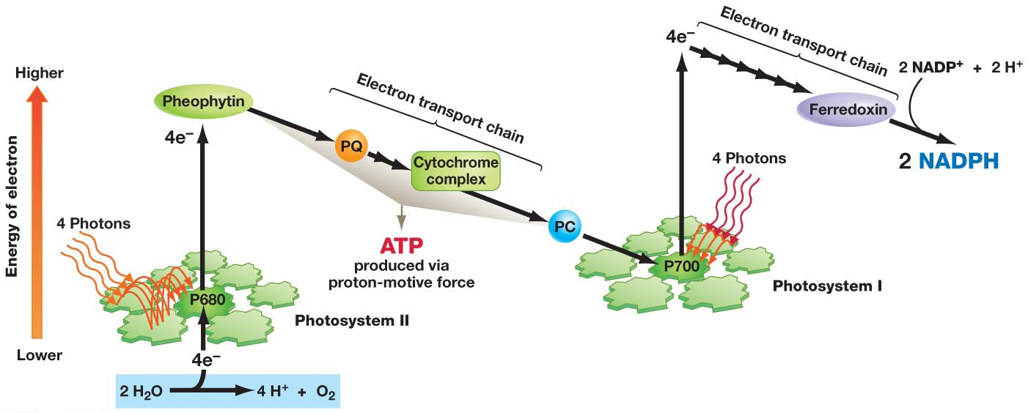

Slide 25
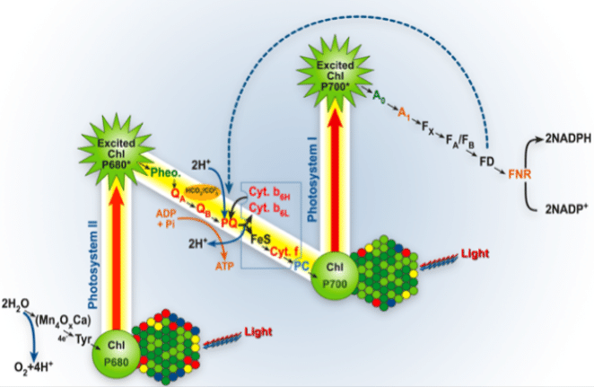

Slide 27
The electrons are not used up as they pass through the electron transport chain, but are passed on to the pigments of photosystem PS I.
Now electrons in the reaction center of PS I are also excited when they receive red light of wavelength 700 nm and are transferred to another accepter molecule that has a greater redox potential.
Electron hole created in PS-I is filled up by the electron from PS-II.
Electron from PS-I passed down hill and reduce NADP⁺ into NADPH + H⁺.

Slide 28
During the process of transport of electron, transfer of electron takes place, starting from the PS II, uphill to the accepter, down the electron transport chain to PS I, excitation of electrons, transfer to another accepter, and finally down hill to NADP⁺ causing it to be reduced to NADPH + H⁺ is called the Z scheme, due to its characteristic shape.
This shape is formed when all the carriers are placed in a sequence on a redox potential scale.

Slide 29
Splitting of Water
Electron required for Electron transport system is fulfilled by splitting of water- Photolysis- associated with PS II
PS-II loose electrons continuously, filled up by electrons released due to photolysis of water.
Water is split into H⁺, O₂ and electrons in presence of light and Mn²⁺ and Cl⁻.
This also creates O₂ the bi-product of photosynthesis.
Photolysis takes place in the vicinity of the PS-II.
•
•

Slide 30
Photophosphorylation
•
The process of formation of high-energy chemicals (ATP and NADPH) in the presence of light
Also defined as – Photophosphorylation is the synthesis of ATP from ADP and inorganic phosphate in the presence of light.
Phosphorylation is the process by which living organisms extract energy from oxidisable substances and store this in the form of bond energy like ATP
Phosphorylation takes place inside the cell in mitochondria & chloroplast.
It is of two types:
•
•
•
Cyclic photophosphorylation
Non- cyclic photophosphorylation

Slide 31
NON- CYCLIC PHOTOPHOSPHORYLATION:
Two photosystems work in series – First PSII and then PSI.
These two photosystems are connected through an electron transport chain (Z. Scheme).
ATP and NADPH + H⁺ are synthesized by this process. PSI
and PSII are found in lamellae of process is carried here.
CYCLIC PHOTOPHOSPHORYLATION :
grana, hence this
Only PS-I works, the electron circulates within the photosystem.
It happens in the stroma lamellae (possible location) because in this region PS-II and NADP reductase enzyme are absent.
Hence only ATP molecules are synthesized.

Slide 32
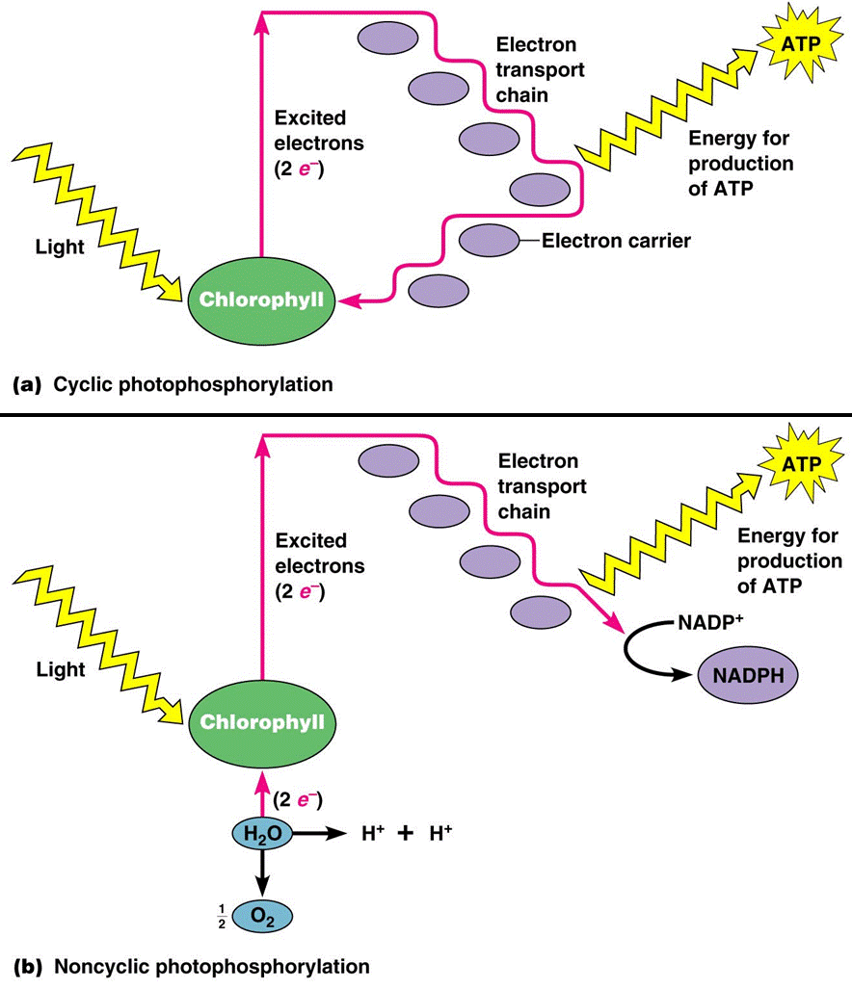

Slide 33
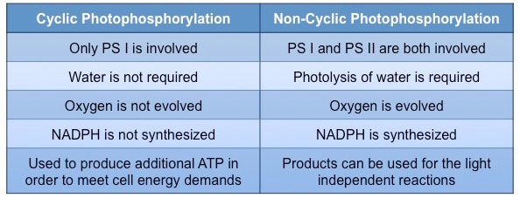

Slide 34
Chemiosmotic Hypothesis
•
The chemiosmotic hypothesis has been put forward to explain the mechanism of ATP synthesis which is linked to development of a proton gradient across membranes of the thylakoid.
Here the proton accumulation takes place towards the inside of the membrane, i.e., in the lumen.
The protons that are produced by the splitting of water are accumulated inside of membrane of thylakoids (in lumen).
As the electron moves through the photosystem, protons are transported across the membrane.
•
•
•

Slide 36
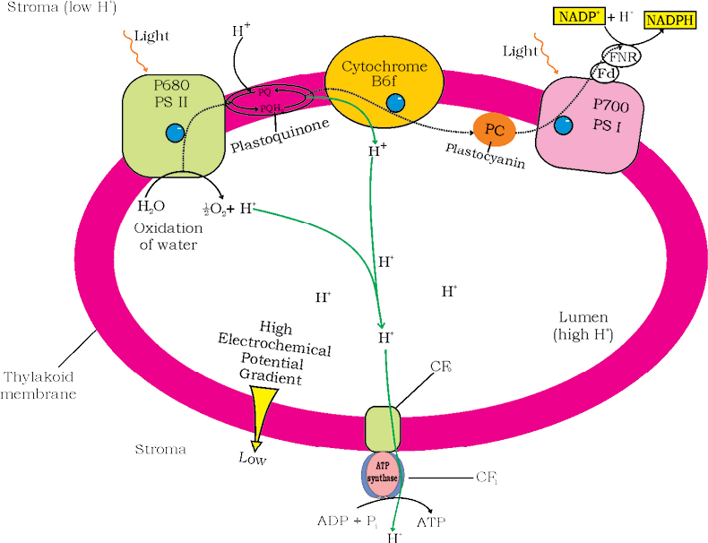

Slide 37
•
NADP reductase enzyme is located on the stroma side of the membrane, along with electrons from the acceptor it removes H⁺ from the stroma during reduction of NADPH+ H⁺.
This creates proton gradients across the thylakoid membrane as well as a measurable decrease in pH in the lumen.
ATPase has a channel that allows diffusion of protons back to stroma across the membrane.
This releases energy to activate ATPase enzyme that catalyses the formation of ATP.
Chemiosmosis requires a membrane, a proton pump, a proton gradient and ATPase. Energy is used to pump protons across a membrane, to create a gradient or a high concentration of protons within the thylakoid lumen.
•
•
•
•

Slide 38
In 1963, ferredoxin-NADP reductase (FNR) was isolated and purified to a crystalline form. This proved that the FNR—connectein complex, which binds to a specific site on the surface of thylakoid membrane, is functionally responsible for NADP photoreduction in chloroplasts.
The chemiosmotic hypothesis was proposed by Peter Mitchell. This hypothesis stated that a proton-motive force was responsible for driving the synthesis of ATP. In this hypothesis, protons would be pumped across the inner mitochondrial membrane as electrons went through the electron transfer chain.
Chemiosmotic hypothesis given by Peter Mitchell process the mechanism of [ KCET 2011]
Synthesis of ATP
Synthesis of FADH2
Synthesis of NADH
Synthesis of NADPH

Slide 39
How ATP & NADPH is used?
ATP, NADPH and O₂ are the products of light reaction.
O₂ diffuses out of the chloroplast while ATP and NADPH are used to drive the processes leading to the synthesis of food, i.e., sugars- biosynthetic phase of photosynthesis.
This process does not directly depend on the presence of light but is dependent on the products of the light reaction, i.e., ATP and NADPH, besides CO₂ and H₂O.
Melvin Calvin after world war II worked with radioactive ¹⁴C & studied algal photosynthesis which led to the discovery that the first CO₂ fixation product was a 3-carbon organic acid- 3-phosphoglyceric acid/ PGA.
•
•

Slide 40
REDUCTION OF CARBON DIOXIDE
1.CALVIN CYCLE; The C3 pathway gets its name from the first molecule produced in the cycle (a 3-carbon molecule) called 3-phosphoglyceric acid.
2.HATCH AND SLACK PATHWAY: The C4 process is also known as the Hatch-Slack pathway and is named for the 4-carbon intermediate molecules that is oxaloacetic acid(OAA).
3.PHOTORESPIRATION:Photorespiration is also called as C2 cycle because of the formation of 2-carbon intermediates.
4.CAM: Plants that use crassulacean acid metabolism, also known as CAM plants, are succulents that are efficient at storing water due to the dry and arid climates they live in. CAM plants keep their stoma close during the day to prevent water loss. Instead, the stoma are opened at night to take in carbon dioxide from the atmosphere.

Slide 41
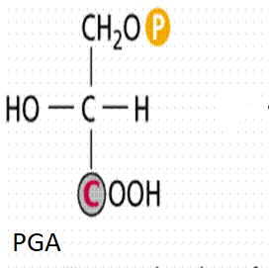
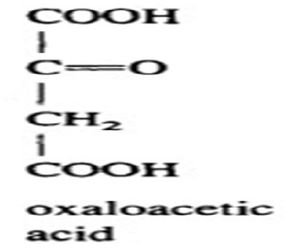
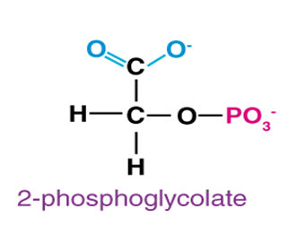

Slide 42
He explained complete biosynthetic pathway & named that as Calvin cycle
Further work of scientists led to the discovery of another set of plants in which the first stable product of CO₂ fixation was 4 carbon acid- oxaloacetic acid or OAA.
•
•
•
Accordingly those plants in which the first product of CO₂
fixation is a C₃ acid (PGA)- C₃ pathway, and those in which the first product was a C4 acid (OAA)- C₄ pathway.

Slide 43
Dark Reaction of Photosynthesis
The process of photosynthesis start when CO₂ is accepted by primary acceptor
The primary acceptor molecule is 5- carbon ketose sugar- Ribulose biphosphate (RuBP)
The cycle was discovered in 1950 by Melvin Calvin, James Bassham, and Andrew Benson at the University of California, Berkeley by using the radioactive isotope carbon-14. Photosynthesis occurs in two stages in a cell.
The next step is Calvin cycle, which have three stages:
Carboxylation
Reduction
Regeneration

Slide 44
THE CALVIN CYCLE:
Melvin Calvin and his co-workers proposed Calvin cycle
They showed that the pathway operated in a cyclic manner; the RuBP was regenerated.
The Calvin pathway occurs in all photosynthetic plants; it does not matter whether they have C₃ or C₄ (or any other) pathways.
1.Carboxylation:
Carboxylation is the fixation of CO₂ into a stable organic intermediate where CO₂ is utilized for the carboxylation of RuBP.

Slide 45
This reaction is catalysed by the enzyme RuBP carboxylase which results in the formation of two molecules of 3-PGA.
The enzyme also has an oxygenation activity so it is also called RuBP carboxylase-oxygenase or RuBisCO.
2. Reduction:
•
•
Series of reactions that lead to the formation of glucose.
Involves utilization of 2 molecules of ATP for phosphorylation and two of NADPH for reduction per CO₂ molecule fixed.

Slide 46
The fixation of six molecules of CO₂ and 6 turns of the cycle are required for the removal of one molecule of glucose from the pathway.
3. Regeneration:
•
Regeneration of the CO₂ acceptor molecule RuBP is crucial if the cycle is to continue uninterrupted.
The regeneration steps require one ATP for phosphorylation to form RuBP
For every CO₂ molecule entering the Calvin cycle, 3 molecules of ATP and 2 of NADPH are required.

Slide 48
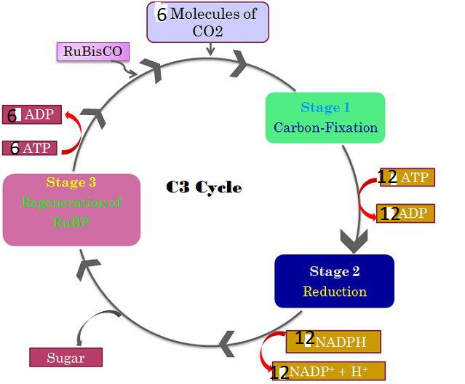

Slide 49
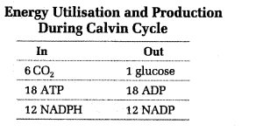

Slide 50
1. In photosynthesis dark reaction, is called so because-
A. It occurs in dark.
B. It does not require light energy.
C. It cannot occur during daytime.
D. It occurs more rapidly at night.
Ans: B
2. Rate of photosynthesis does not depend upon:
A. Quality of light
B. Intensity of Light
C. Duration of Light
D. Temperature
Ans: C
3. For photosynthesis green plants require:
A. Chlorophyll only
B. Light
C. Carbon dioxide and water
D. All of the above
Ans: D

Slide 51
4. Photosynthesis is a _____ process. A. Catabolic
B. Anabolic
C. Exothermic
D. Metabolic
Ans: B 5. Name the pigment which is responsible for absorption of light in plants? A. Chlorophyll
B. Stoma
C. Xylem
D. Phloem
Ans: A
6. In bacteria name the colour of light which is responsible for photosynthesis?
A. Ultra-Violet
B. Blue
C. Red
D. None of the above
Ans: C 7. Quantasomes are found in: A. Cristae of mitochondria
B. Thylakoid membrane of chloroplasts
C. Nucleus membrane
D. Lysosome
Ans: B

Slide 52
8. Name the metal present in chlorophyll ‘a’ and ‘b’?
A. Iron
B. Copper
C. Magnesium
D. Manganese
Ans: C
9. Name the structural unit of photosynthesis?
A. Thylakoid
B. Grana
C. Stroma
D. Chlorophyll
Ans: A
10. Which of the following statements are true regarding Photosystems?
A. Photosystems are arrangements of chlorophyll and other pigments packed into thylakoids.
B. Many Prokaryotes have only one photosystem.
C. Both A and B are correct.
D. Only A is correct.
Ans: C

Slide 53
The C₄ pathway
Plants that are adapted to dry tropical regions have the C₄ pathway.
C₄ oxalo acetic acid is the first CO₂ fixation product
The plants with C₄ pathway does follow Calvin cycle as the main biosynthetic pathway.
C₄ plants differ from C₃ plants by having special type of leaf anatomy, they tolerate higher temperatures, they show a response to highlight intensities, they lack a
process called photorespiration and have greater productivity of biomass.
•
•

Slide 54
•
Kranz anatomy is a specialized structure in C₄ Plants where the mesophyll cells are clustered around the bundle-sheath cells in a ring-like fashion. This is found in C₄ grasses such as maize and a few dicots.
The bundle sheath cells may form several layers around the vascular bundles & have large number of chloroplasts, thick walls impervious to gaseous exchange and no intercellular spaces.
The pathway followed by C₄ plants are called the Hatch and Slack Pathway, is again a cyclic process
•
•

Slide 55
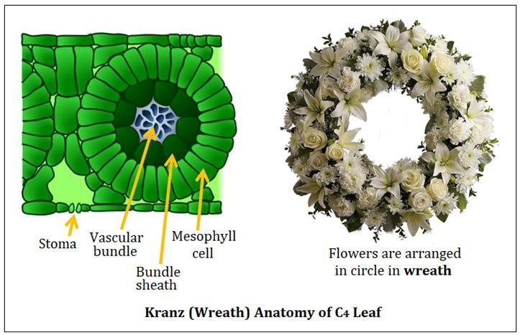

Slide 56
The tissues involved in the process of C₄ pathway are mesophyll & bundle sheath cells
The process starts in mesophyll when CO₂ is accepted by primary CO₂ acceptor which is 3-carbon molecule phosphoenol pyruvate (PEP)- catalyzed by PEP carboxylase or PEPcase.
Mesophyll cells lack RuBisCO enzyme.
The C4 acid Oxaloacetic acid (OAA) is formed in the mesophyll cells which then forms other 4-carbon compounds like malic acid or aspartic acid in the mesophyll cells
Malic acid formed are transported to the bundle sheath cells.
•
•
•
•

Slide 57
•
In the bundle sheath cells these C4 acids are broken down to release CO₂ and a 3-carbon molecule.
The 3-carbon molecule is transported back to the mesophyll where it is converted to PEP again, thus, completing the cycle.
The CO₂ released in the bundle sheath cells enters the C₃ or the Calvin pathway, a pathway common to all plants.
The bundle sheath cells are rich in an enzyme Ribulose bisphosphate carboxylase-oxygenase (RuBisCO), but lack PEPcase. Thus, the basic pathway that results in the formation of the sugars, the Calvin pathway, is common to the C₃ and C₄ plants.
•
•
•

Slide 58
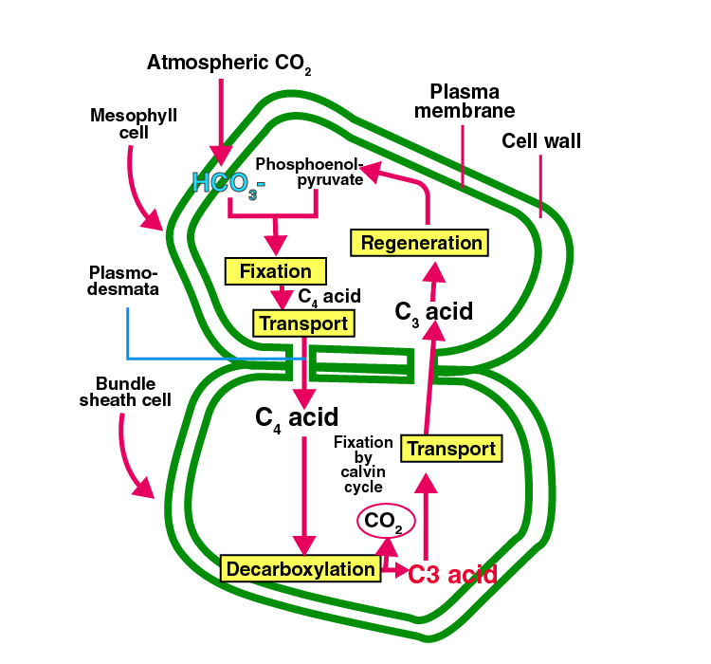

Slide 59
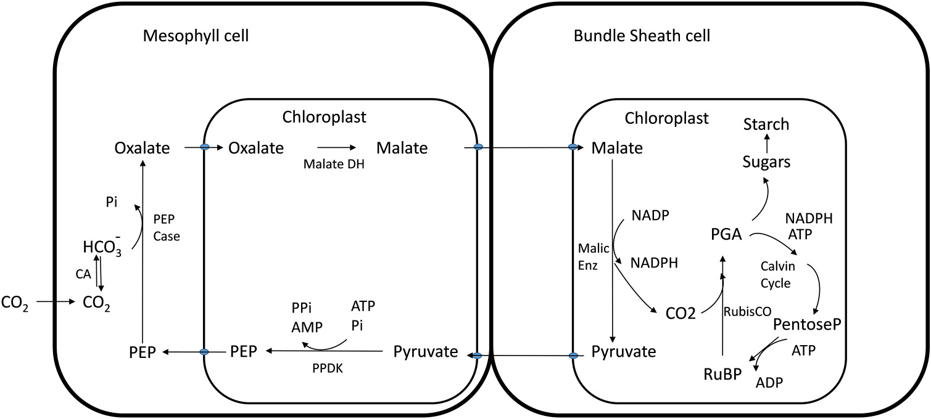

Slide 60
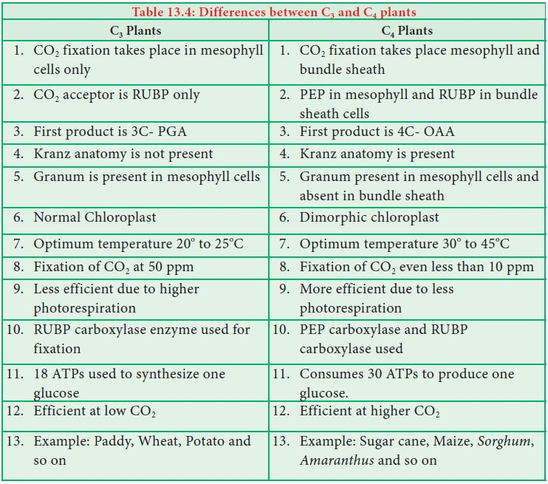

Slide 61
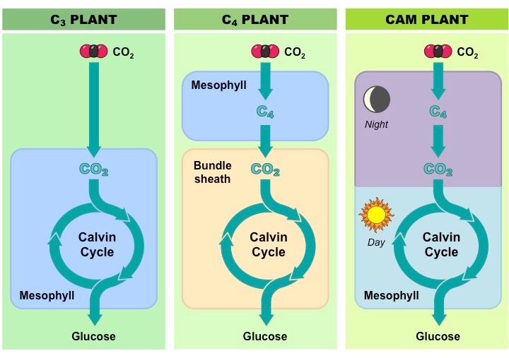

Slide 62
PHOTORESPIRATION
Photorespiration (also known as the oxidative photosynthetic carbon cycle, or C₂ photosynthesis) refers to a process in plant metabolism where the enzyme RuBisCO oxygenates RuBP wasting some of the energy produced by photosynthesis.
The desired reaction is the addition of carbon dioxide to RuBP (carboxylation), a key step in the Calvin–Benson cycle, but approximately 25% of reactions by RuBisCO instead add oxygen to RuBP (oxygenation), creating a product that cannot be used within the Calvin–Benson cycle. This process reduces the efficiency of photosynthesis, potentially reducing photosynthetic output by 25% in C₃ plants.
Photorespiration involves a complex network of enzyme reactions that exchange metabolites between chloroplasts, leaf peroxisomes and mitochondria

Slide 63
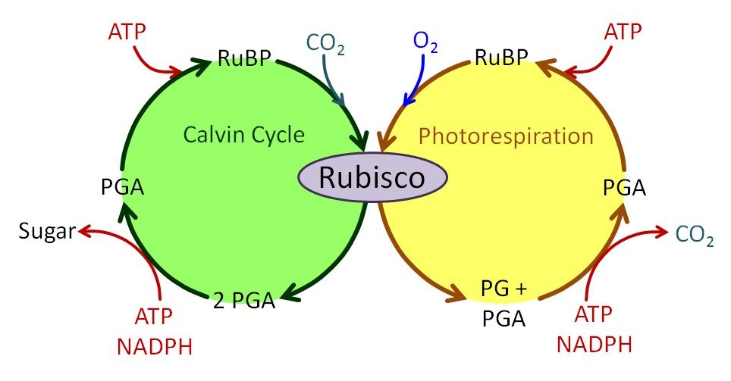

Slide 64
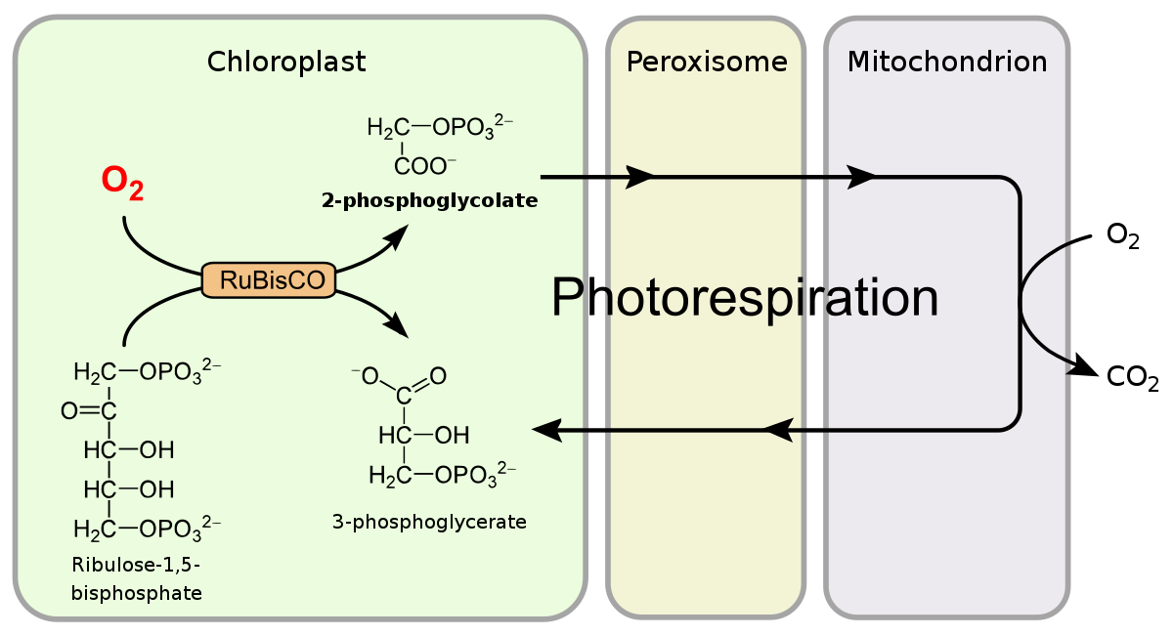

Slide 65
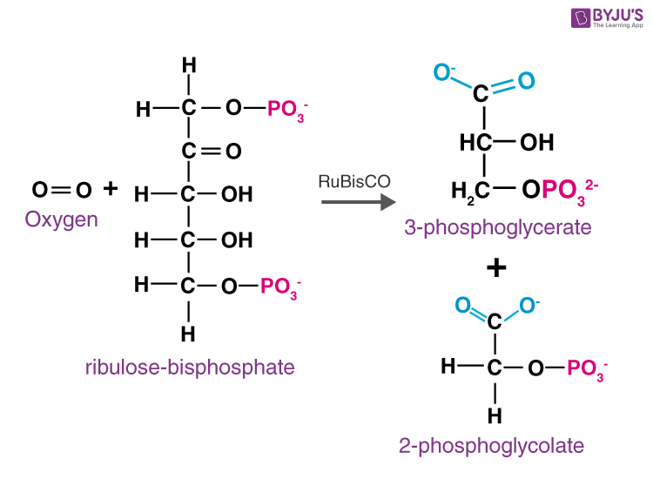

Slide 66
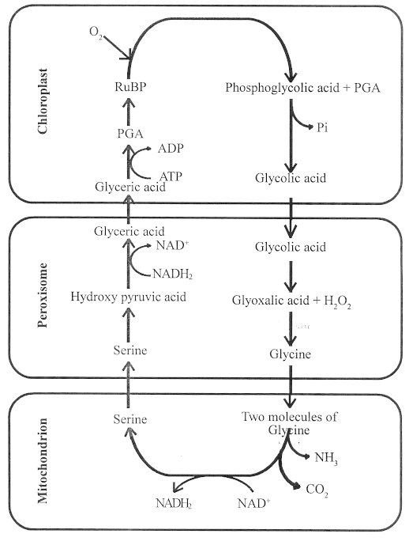

Slide 67
Factors affecting Photosynthesis
•
The external factors which affects photosynthesis include the availability of sunlight, temperature, CO2 concentration and water
Blackman’s (1905) Law of Limiting Factors:
“If a chemical process is affected by more than one factor, then its rate will be determined by the factor which is nearest to its minimal value: it is the factor which directly affects the process if its quantity is changed.”
•
•
1. Light:
At low intensities of light, there is a linear relationship between incident light and carbon fixation.
At high intensities of light, the rate does not show further increase because other factors become limiting.

Slide 68
•
Increase in incident light beyond a point results in the breakdown of chlorophyll and a decrease in photosynthesis.
2. Carbon dioxide Concentration:
Carbon dioxide is a major limiting factor for photosynthesis.
It is important to remember that carbon dioxide is in very low concentration in the atmosphere (0.03 – 0.04%).
Increase in concentration up to 0.05% can increase carbon fixation. An increase beyond this level can be damaging over longer periods
•
•

Slide 69
3. Temperature:
The dark reactions are controlled by temperature because they are enzymatic.
Light reactions are also sensitive to temperature but to a much lesser extent.
The C4 plants have a much higher temperature optimum than C3 plants.
The temperature optimum for a particular plant also depends on it natural habitat.
Tropical plants have a higher temperature optimum than temperate plants.

Slide 70
4. Water:
The effect of water is more on the plant rather than directly on photosynthesis.
Water stress results in closing of stomata and; thus in reduced availability of CO₂.
Water stress also leads to wilting of leaves. Wilting of leaves means reduced surface area and reduced metabolic activity in leaves.

